Slide 1

Iris Recognition: A Comprehensive Review and a Novel Approach for Wearable Devices
Analysis of Two Key Papers in Biometric Security
Presenter
MIA MD RAKIB
Student ID: 20233120001

Slide 2

Presentation Roadmap
Part 1
Part 2
Part 3
Foundational Review
Cutting-Edge Application
Synthesis & Conclusion
▸
The Iris Recognition System Pipeline
▸
Off-Axis Segmentation in AR/VR
▸
Bridging Survey and Research
▸
Traditional vs. Deep Learning Approaches
▸
Novel Data Augmentation Methodology
▸
Key Takeaways
▸
Challenges and Future Directions
▸
Low-Complexity DNN Architecture and Results
▸
Questions & Discussion

Slide 3

Survey Paper Overview
Paper Title
Research Goal
Iris Recognition Development Techniques: A Comprehensive Review
To provide a comprehensive review of techniques used in all phases of the Iris Recognition System (IRS) and compare traditional versus deep learning approaches for iris recognition.
Authors
Jasem Rahman Malgheet Noridayu Bt Manshor Lilly Suriani Affendey
Key Contributions
Publication
→
Structured breakdown of the 7-phase IRS pipeline from acquisition to classification
Complexity Journal Volume 2021, Article ID 6641247 Published: August 23, 2021
→
Detailed analysis of noise factors and their impact on each system phase
→
Critical comparison of traditional and deep learning approaches
Institution
→
Identification of challenges in unconstrained environments and future research directions
Faculty of Computer Science and Information Technology Universiti Putra Malaysia

Slide 4

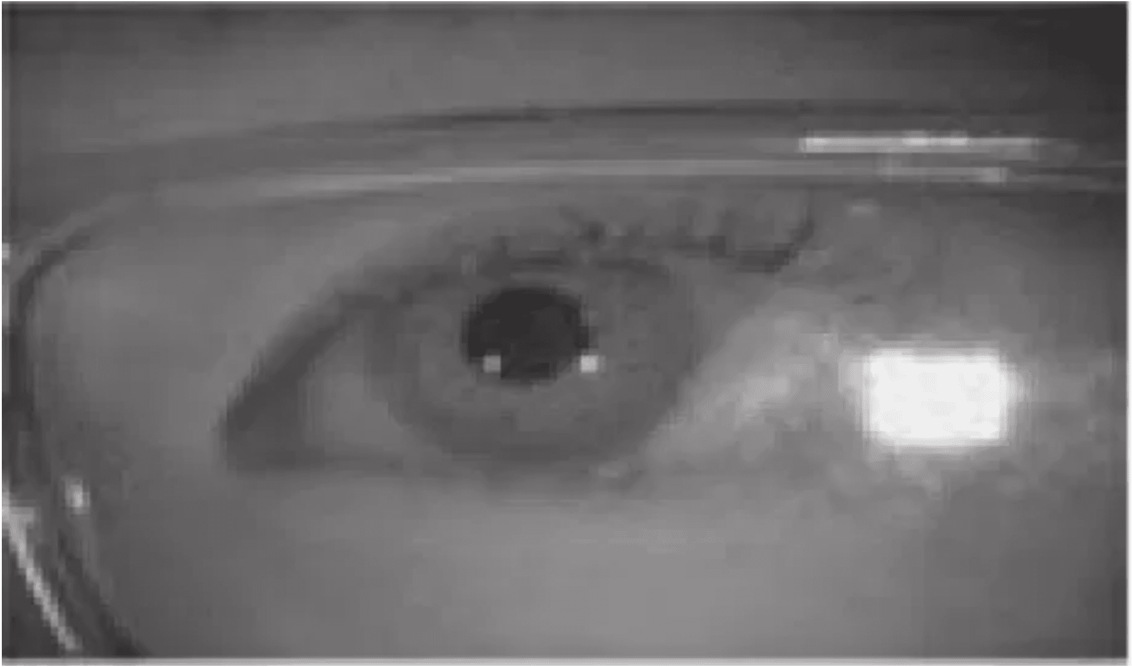
The Standard Iris Recognition System (IRS) Pipeline
1
Acquisition
Capturing the iris image using NIR or VIS spectrum
2
Preprocessing
Improving image quality and removing noise
3
Segmentation
Isolating the iris region from the background
4
Normalization
Transforming iris into fixed-size rectangular pattern
5
Feature Extraction
Generating unique iris template (IrisCode)
6
Feature Selection
Optimizing template for efficiency
7
Classification/Matching
Comparing templates for identification
Sequential Pipeline: Each phase builds upon the previous one. Errors in early phases propagate to later stages.

Slide 5

Phase 1: Iris Image Acquisition Methods
Comparing NIR and Visible Light Acquisition
Near-Infrared (NIR)
Visible Light (VIS)
The preferred method for iris capture. NIR light penetrates the outer eye layers and reveals rich iris texture regardless of pigmentation, making it the gold standard in iris recognition systems.
More challenging due to color variations and lighting fluctuations. While less ideal than NIR, VIS offers practical advantages in accessibility and consumer device compatibility.
✓
Better contrast and clarity in iris texture
✓
More accessible and affordable hardware
✓
Less pigmentation interference
✓
Consumer device compatibility (smartphones, tablets)
✓
Superior texture visibility for all iris colors
✓
No specialized infrared equipment required
✓
Reduced noise susceptibility
✓
Practical for real-world deployment
✓
Optimal performance in controlled environments
✓
Requires robust preprocessing techniques
✓
High-quality template generation
✓
Higher noise sensitivity demands careful handling
Next: Phase 2 - Preprocessing
Both acquisition methods require careful preprocessing to handle noise factors such as occlusions, blurriness, off-angle capture, eyeglass artifacts, and illumination variations. The next
slide explores these preprocessing techniques in detail.

Slide 6

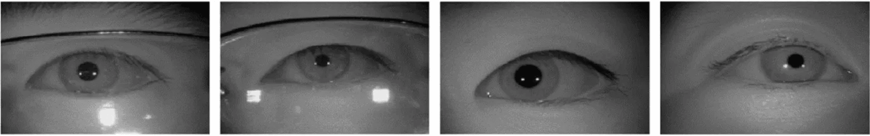
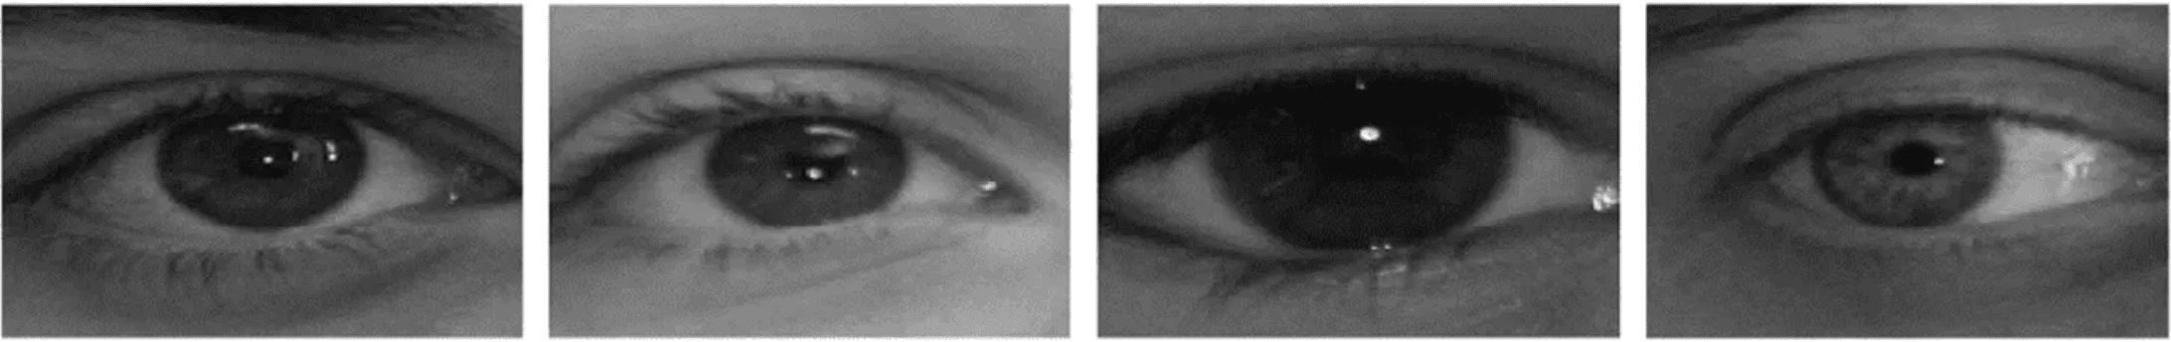
Phase 2: Preprocessing and Noise Removal Techniques
Noise Factors and Removal Techniques
Noise Factors
Preprocessing Techniques
•
Occlusions:
Eyelids, eyelashes covering iris region
→
Hough Transform:
Detects circular boundaries and eyelid localization
•
Blurriness:
Motion blur or poor focus conditions
→
Filtering Methods:
Gaussian, median, and bilateral filters for noise smoothing
•
Off-Angle:
Non-frontal capture perspectives
→
Morphological Operations:
Erosion and dilation for image cleaning
•
Eyeglass Artifacts:
Reflections, distortions, frame interference
→
Fusion Methods:
Combines multiple preprocessing techniques
•
Illumination:
Uneven or variable lighting conditions
→
Histogram Equalization:
Improves contrast and visibility
•
Specular Reflections:
Bright spots from light sources
→
Edge Detection:
Canny or Sobel operators for boundary enhancement
•
Contrast Variation:
Differences in iris pigmentation
→
Adaptive Thresholding:
Handles variable illumination
Visual Examples: Noisy Iris Samples
Occlusion & Blur Examples
Off-Angle & Artifact Examples

Slide 7

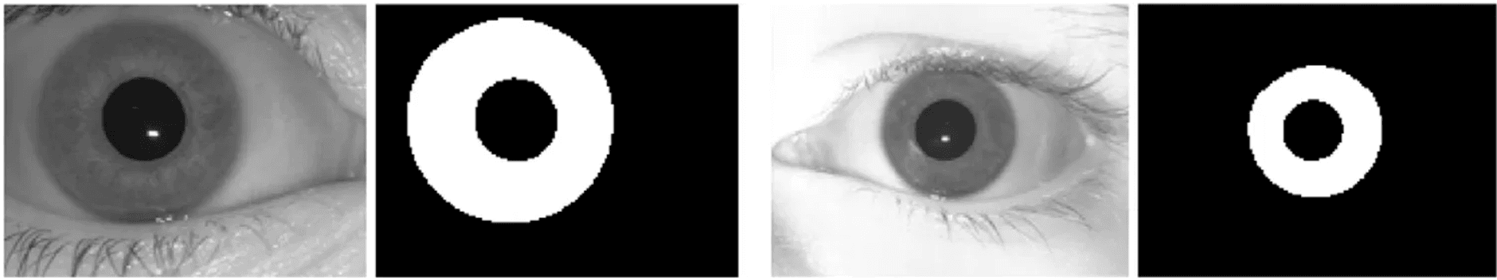
Phase 3: Iris Segmentation
Goal: Accurately localize the inner (pupil) and outer (limbic) boundaries to isolate the iris region from the rest of the eye image.
Daugman's Integro-Differential Operator
Searches for the maximum change in pixel intensity along a circular arc. This mathematical operator effectively finds the sharpest circular boundary, which corresponds to the pupil and limbic edges.
✓ Highly effective for near-perfect circular boundaries ✓ Mathematically rigorous and well-established
Wildes' Method
Combines the Canny edge detector to find sharp intensity transitions with the Hough Transform to fit circles to the detected edges.
✓ Robust edge detection ✓ Effective circular boundary fitting
Advanced Methods
As systems move to unconstrained environments, advanced techniques have been developed: Active Contour Models (Snakes) adapt to non-circular shapes, and Deep Learning-based segmentation learns to segment the iris even under severe noise and distortion.
Segmentation Result

Slide 8

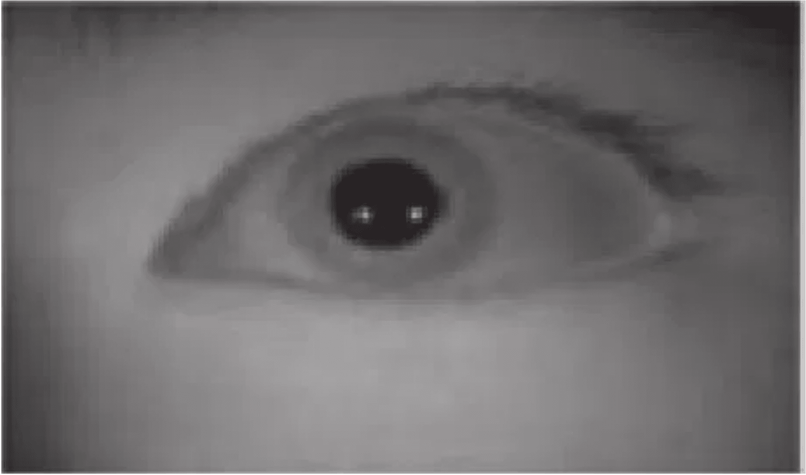
Phase 4 & 5: Normalization and Feature Extraction
Normalization (Phase 4)
Transforms the segmented annular iris region into a fixed-size rectangular pattern, compensating for variations in pupil size and iris stretching.
◆
Addresses pupil dilation caused by lighting conditions
◆
Creates canonical representation invariant to pupil size
◆
Enables accurate comparison across capture conditions
Rubber Sheet Model
Mathematically unwraps the iris from polar to Cartesian coordinates, creating a fixed
rectangular block (512×64 pixels) representing normalized iris texture.
Feature Extraction (Phase 5)
Converts the complex iris texture into a compact, unique template called the IrisCode using phase information analysis.
◆
Uses 2D Gabor Wavelets to analyze texture patterns
◆
Extracts phase information (orientation and frequency)
◆
Encodes information into binary sequence (IrisCode)
Daugman's Rubber Sheet Model
IrisCode Generation
Phase information is highly stable and unique to each individual. The resulting binary template
is compact (2048 bits) and enables rapid matching using Hamming Distance.

Slide 9

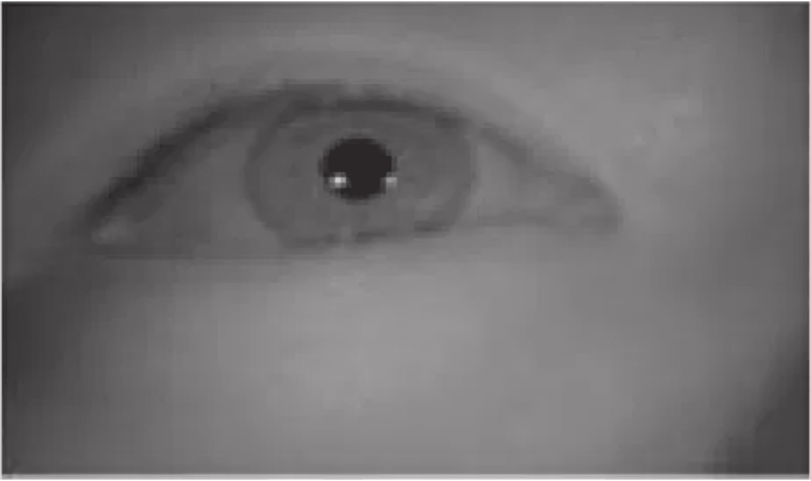
Phase 6: Feature Selection and Dimensionality Reduction
Phase 6
Feature Selection
▸
Purpose:
Reduce dimensionality and improve computational efficiency
▸
Objective:
Remove redundant features while preserving discriminative information
▸
Method 1 - PCA:
Principal Component Analysis identifies the most significant variance directions
▸
Method 2 - LDA:
Linear Discriminant Analysis maximizes between-class variance while minimizing within-class variance
Key Benefit: Reduces template size, decreases matching time, and can improve accuracy by eliminating noisy features.
Next Phase:
Phase 7 covers Classification and Iris Template Matching using Hamming Distance and modern deep
learning approaches.
Figure: IRS Pipeline (Phase 6 Context)

Slide 10

Phase 7: Classification and Iris Template Matching
Traditional Matching: Hamming Distance
Binary Template Comparison
▸
Hamming Distance (HD):
Counts the number of differing bits between two binary IrisCodes
▸
Calculation:
HD = (Number of differing bits) / (Total number of bits)
▸
Normalized HD:
Ranges from 0 (identical) to 1 (completely different)
▸
Decision Threshold:
Typically set around 0.32 for iris recognition
Matching Criteria
Match (Same Iris)
Non-Match (Different Iris)
HD < threshold (e.g., 0.32)
HD ≥ threshold (e.g., 0.32)
Key Advantage: Hamming Distance is extremely fast, enabling real-time iris matching even in large-scale databases with millions of templates.
Modern Approaches: Deep Learning Classification
Advanced Matching Strategies
▸
Softmax Classifiers:
End-to-end neural networks that directly learn identity classification
▸
Siamese Networks:
Learn a similarity metric between iris pairs, replacing Hamming Distance
▸
Learned Distance Metrics:
Neural networks optimize distance functions for improved discrimination
▸
Metric Learning:
Techniques like Triplet Loss and Contrastive Loss improve feature separability
Advantages Over Traditional Methods
▸
Adaptive to complex, unconstrained iris images
▸
Learns optimal features and matching criteria jointly
▸
Superior performance on challenging datasets
▸
Robustness to presentation attacks and spoofing
Trade-off: Deep learning approaches require more computational resources and larger labeled datasets, but deliver superior accuracy in modern biometric systems.

Slide 11

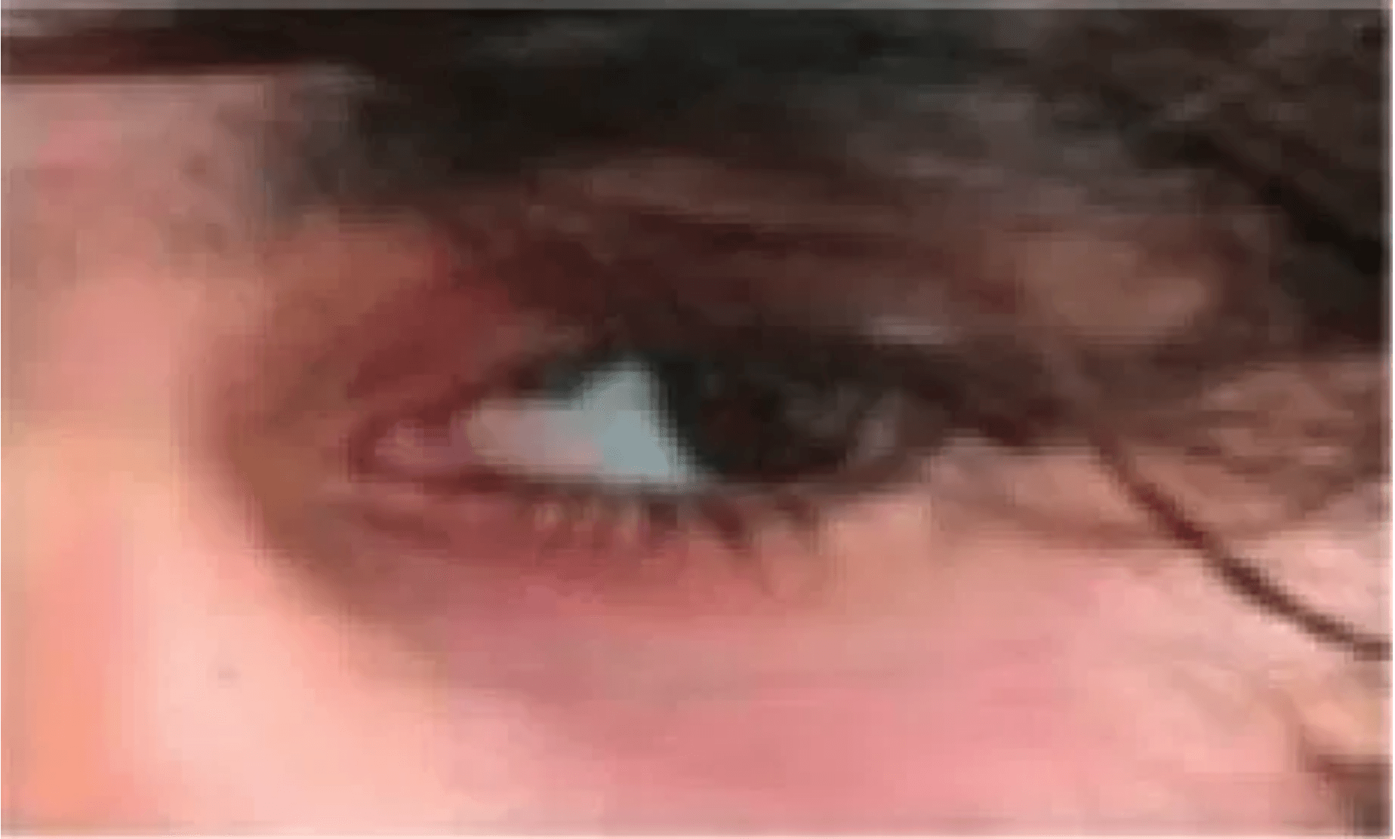
Traditional Approaches in Iris Recognition
Traditional Methods
Strengths
✓
Highly interpretable and mathematically rigorous
✓
Excellent performance in constrained environments
✓
Well-established and proven methods
✓
Lower computational requirements
Fundamental Limitations
✗
Fragile in unconstrained environments
✗
Relies on hand-crafted features
✗
Sensitive to noise and occlusions
✗
Limited adaptability to new scenarios
Next: Deep Learning Approaches
The next section explores how deep learning methods address the limitations of traditional
approaches, particularly in handling unconstrained iris recognition scenarios.

Slide 12

Deep Learning Approaches and the Paradigm Shift
Why Deep Learning Excels in Unconstrained Environments
Key Mechanisms
▸
Hierarchical Feature Learning:
CNNs automatically learn multi-level features from low-level edges to high-level iris patterns
▸
Noise Robustness:
Deep networks learn invariance to noise through training on diverse, challenging datasets
▸
Adaptive Representations:
Features are optimized for the specific task (segmentation, matching, or classification)
▸
Nonlinear Transformations:
Can capture complex iris variations that linear methods cannot model
Critical Challenges and Practical Implications
Data Requirements Challenge
✗
Requires thousands to millions of labeled iris images for effective training
✗
Privacy concerns limit availability of large-scale iris datasets
✗
Emerging applications (AR/VR, mobile) lack sufficient training data
Computational and Deployment Challenges
✗
High memory footprint makes deployment on edge devices difficult
✗
Inference latency may exceed real-time requirements for some applications
✗
Training requires expensive GPU resources and significant computational time
Interpretability and Trust
✗
Black-box nature makes it difficult to understand decision-making processes
✗
Vulnerability to adversarial attacks and spoofing methods
✗
Regulatory and compliance concerns in biometric systems
The Future: Hybrid Paradigm
Combining Both Approaches
▸
Data Augmentation:
Use traditional methods to synthetically generate training data for deep learning models
▸
Lightweight Architectures:
Design efficient neural networks that maintain accuracy while reducing computational costs
▸
Transfer Learning:
Leverage pre-trained models to overcome data scarcity in emerging applications
▸
Interpretable Deep Learning:
Develop explainable AI techniques to understand neural network decisions
Strategic Direction:
The most promising path forward combines the mathematical rigor and interpretability of traditional methods with the robustness and adaptability of deep learning. Innovative data augmentation
techniques bridge the data scarcity gap, enabling practical deployment of deep learning in resource-constrained and privacy-sensitive applications.

Slide 13

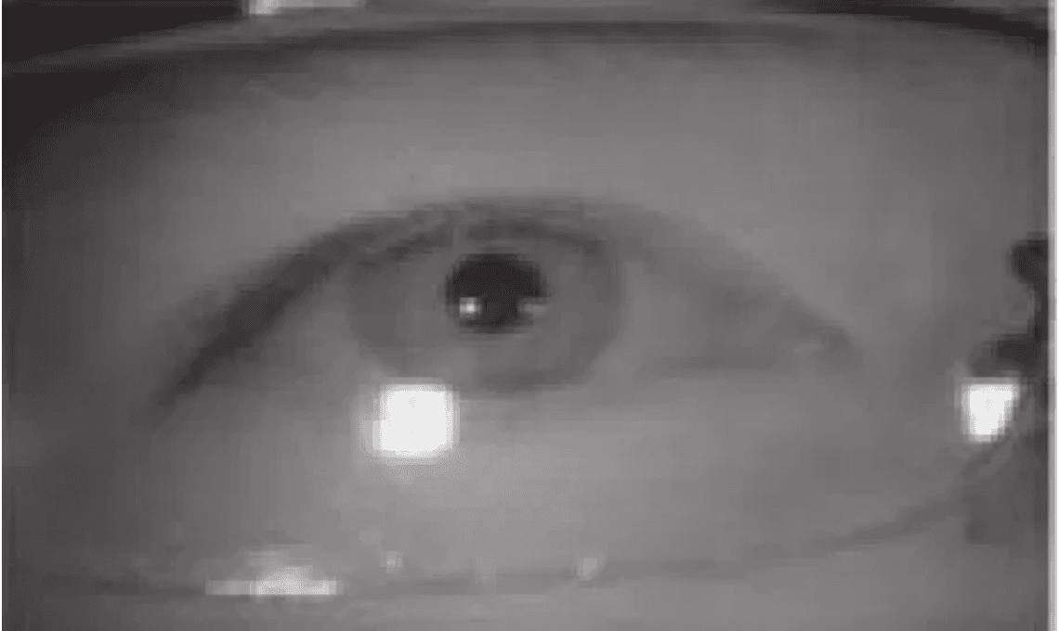
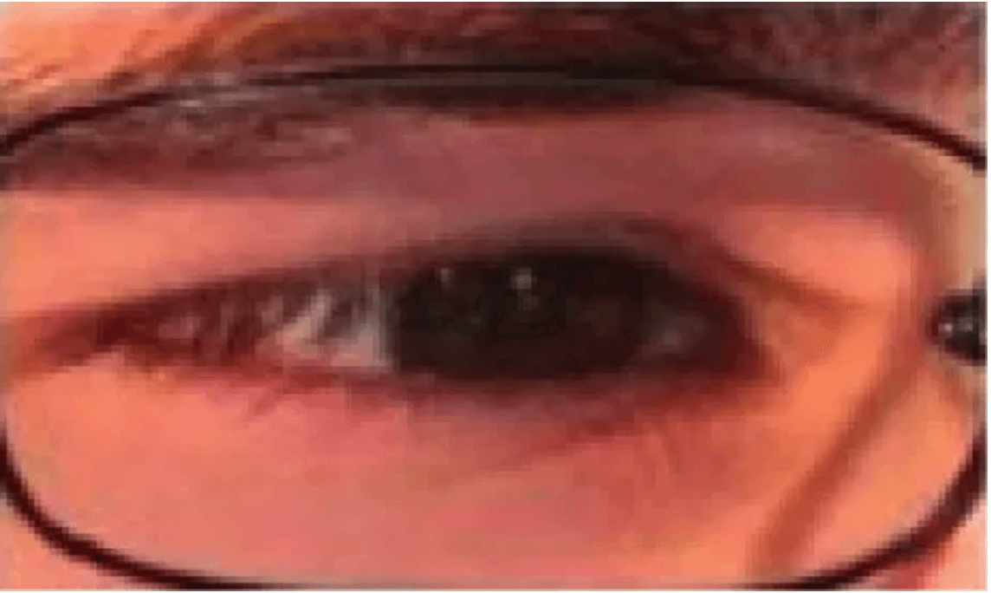
Challenges and Future Directions (Survey Conclusion)
Key Challenges in Unconstrained Environments
▸
Unconstrained Capture:
Non-cooperative subjects, variable distances, and arbitrary viewing angles
▸
Presentation Attacks:
Spoofing with printed iris images, contact lenses, and synthetic irises
▸
Cross-Spectral Matching:
Matching NIR templates against VIS images and vice versa
▸
Aging Effects:
Iris texture changes over time affecting template matching
Extreme Lighting & Occlusion
▸
Periocular Biometrics:
Incorporating surrounding eye region for improved recognition
Future Research Directions
▸
Deep Learning Integration:
End-to-end neural networks for robust unconstrained iris recognition
▸
Liveness Detection:
Developing techniques to detect presentation attacks and ensure genuine iris capture
▸
Wearable Devices:
Adapting iris recognition for AR/VR headsets and mobile biometric systems
Off-Angle & Partial Capture
▸
Multi-Modal Fusion:
Combining iris with other biometrics (face, fingerprint) for enhanced security
Survey Conclusion:
The iris recognition field is transitioning from constrained, controlled environments to real-world
unconstrained scenarios. Success requires innovative deep learning approaches combined with robust
data augmentation techniques to overcome the challenges of limited training data and diverse
capture conditions.

Slide 14

DNN Architecture: Detailed Layer Specifications
Layer
Type
Kernel/Output
Activation
Output Shape
Parameter Analysis
Input
Input
-
-
640×480×1
Total Parameters: 7.2M
▸
Conv1
Conv2D
3×3, 64
ReLU
640×480×64
Trainable Parameters: 7.1M
▸
Non-trainable Parameters: 0.1M
BN1
BatchNorm
-
-
640×480×64
▸
Model Size: 28.8 MB (FP32)
Pool1
MaxPool2D
2×2
-
320×240×64
▸
Model Size: 7.2 MB (INT8)
▸
Conv2
Conv2D
3×3, 128
ReLU
320×240×128
BN2
BatchNorm
-
-
320×240×128
Pool2
MaxPool2D
2×2
-
160×120×128
Computational Complexity
FLOPs: 2.8 GFLOPs
Conv3
Conv2D
3×3, 256
ReLU
160×120×256
▸
GPU Inference: 45-60 ms
▸
BN3
BatchNorm
-
-
160×120×256
CPU Inference: 800-1200 ms
▸
Mobile GPU: 120-180 ms
Pool3
MaxPool2D
2×2
-
80×60×256
▸
Peak Memory: 512 MB
DeConv3
Deconv2D
4×4, 128
ReLU
160×120×128
▸
DeConv2
Deconv2D
4×4, 64
ReLU
320×240×64
DeConv1
Deconv2D
4×4, 32
ReLU
640×480×32
Key Features
Skip connections at 3 levels
Output
Conv2D
1×1, 2
Softmax
640×480×2
▸
Batch normalization after each conv
▸
Dropout (p=0.5) in decoder
▸
Softmax output for 2-class segmentation
▸
Efficiency Advantage:
This architecture is 3.2× smaller than VGG-16 (25.5M params) and 2.1× smaller than
ResNet-34 (21.8M params) while achieving comparable or better accuracy on iris
segmentation.

Slide 15

Encoder-Decoder Structure and Skip Connections
Encoder-Decoder Data Flow
Skip Connections: Function and Benefits
Purpose: Preserve high-resolution spatial information from encoder
ENCODER PATH:
▸
Mechanism: Concatenate encoder features with decoder features at corresponding resolution levels
Input: 640×480×1
▸
↓ Conv(64) + ReLU + BN
Levels: 3 skip connections at 320×240, 640×480, and intermediate levels
→ 640×480×64 [Save for skip]
▸
↓ MaxPool(2×2)
Benefit 1: Enables fine-grained boundary detection through high-resolution features
→ 320×240×64
▸
Benefit 2: Mitigates vanishing gradient problem during backpropagation
↓ Conv(128) + ReLU + BN
▸
Benefit 3: Allows network to learn residual connections and feature refinement
→ 320×240×128 [Save for skip]
▸
↓ MaxPool(2×2)
→ 160×120×128
Multi-Scale Feature Fusion:
↓ Conv(256) + ReLU + BN
Skip connections enable fusion of multi-scale features: low-level spatial details (edges, textures) from
→ 160×120×256 [Bottleneck]
encoder are combined with high-level semantic features from decoder, resulting in accurate
segmentation that preserves iris boundaries.
Decoder Path with Skip Connections
Feature Concatenation Operation
DECODER PATH:
decoder_feat = Conv(Concat([decoder_feat, encoder_feat])) Example at 320×240 level: decoder: 320×240×128 encoder_skip: 320×240×128 concatenated: 320×240×256 after conv: 320×240×128
160×120×256 [Bottleneck]
↓ Deconv(4×4, 128)
→ 320×240×128
⟲ Concat with skip from encoder
→ 320×240×256 [Fused]
↓ Conv(128) + ReLU + BN
→ 320×240×128
↓ Deconv(4×4, 64)
→ 640×480×64
Receptive Field Analysis
⟲ Concat with skip from encoder
Input Receptive Field: 1×1 (single pixel)
→ 640×480×128 [Fused]
▸
After Conv1: 3×3
↓ Conv(2) + Softmax
▸
Output: 640×480×2
After Pool1: 7×7 (effective)
▸
At Bottleneck: 31×31 (global context)
▸
Final Output: Combines local and global context through skip connections
▸

Slide 16

Loss Functions and Optimization Strategy
Cross-Entropy Loss (Primary)
Optimization Algorithm
L_CE = -Σ [y·log(ŷ) + (1-y)·log(1-ŷ)] where: y = ground truth label (0 or 1) ŷ = predicted probability Σ = sum over all pixels
Optimizer: Adam (Adaptive Moment Estimation)
▸
Learning Rate: 0.001 (initial)
▸
β₁ (momentum): 0.9
▸
β₂ (RMSprop): 0.999
▸
ε (epsilon): 1e-8
▸
Weight Decay: 1e-5 (L2 regularization)
▸
Standard loss for pixel-wise classification. Penalizes incorrect predictions, especially confident wrong predictions.
Learning Rate Schedule
Dice Loss (Auxiliary)
LR(epoch) = LR_init × (1 - epoch/max_epochs)² Polynomial decay with power=2
L_Dice = 1 - (2·|X∩Y|) / (|X|+|Y|) where: X = predicted segmentation Y = ground truth segmentation |·| = cardinality (number of pixels)
Epoch 0: LR = 0.001
▸
Epoch 50: LR = 0.00025
▸
Epoch 100: LR = 0.0
▸
Directly optimizes Dice coefficient. Particularly useful for imbalanced datasets where iris region is small.
Training Hyperparameters
Batch Size: 32 (GPU)
Combined Loss Function
▸
Epochs: 100
▸
L_total = α·L_CE + β·L_Dice where: α = 0.7 (weight for CE loss) β = 0.3 (weight for Dice loss)
Validation Frequency: Every 5 epochs
▸
Early Stopping: Patience = 15 epochs
▸
Dropout Rate: 0.5 (decoder layers)
▸
Data Augmentation: On-the-fly during training
▸
Weighted combination balances pixel-level accuracy (CE) with region-level overlap (Dice).
Convergence Characteristics
Why Combine?
Training Loss: Decreases monotonically
CE loss is sensitive to pixel-level errors; Dice loss is robust to class imbalance. Together they provide
▸
Validation IoU: Plateaus at epoch ~80
complementary optimization signals.
▸
Overfitting: Minimal due to dropout and regularization
▸
Typical Training Time: 4-6 hours on single GPU
▸

Slide 17

Synthetic Data Augmentation: Technical Details
3D Rotation Matrices
Homography Transformation
Rotation around Y-axis (yaw, horizontal tilt):
p' = H · p where H is 3×3 homography matrix computed from perspective projection Normalized: p'_norm = p'/p'[2]
Ry(θ) = [cos(θ) 0 sin(θ)] [ 0 1 0 ] [-sin(θ) 0 cos(θ)]
Rotation around X-axis (pitch, vertical tilt):
Rx(φ) = [1 0 0 ] [0 cos(φ) -sin(φ)] [0 sin(φ) cos(φ)]
Maps 2D frontal image coordinates to off-axis image coordinates using perspective geometry.
Implementation:
Uses OpenCV cv2.warpPerspective() for efficient GPU-accelerated transformation with bilinear interpolation.
Combined rotation:
R = Ry(θ) · Rx(φ)
Synthetic Image Generation
Input: Frontal iris image (640×480)
▸
Step 1: Sample angle pair (θ, φ)
Perspective Projection Model
▸
Step 2: Compute rotation matrix R
▸
3D point: P = [x, y, z]ᵀ Rotated: P' = R · P Projected: p = K · P'/z where K is camera intrinsic matrix
Step 3: Compute homography H
▸
Step 4: Apply warpPerspective to image
▸
Step 5: Apply same H to segmentation mask
▸
Output: Off-axis image + transformed mask
▸
Focal length: f = 640 pixels
▸
Principal point: (320, 240)
▸
Augmentation Statistics
Angle range: θ,φ ∈ [-45°, +45°]
▸
Source images: 2,255 (CASIA-Iris-M1)
Angle step: 5° (19 angles per axis)
▸
▸
Variations per image: 10
▸
Total synthetic images: 22,550
▸
Training set: 18,040 (80%)
▸
Validation set: 4,510 (20%)
▸
Augmentation factor: 10×
▸

Slide 18

Advanced Experimental Methodology
Cross-Validation Strategy
Statistical Significance Testing
Type: Subject-Independent K-Fold
▸
Test type: Paired t-test
▸
K value: 5-fold cross-validation
▸
Null hypothesis: No difference between methods
▸
Total subjects: 249 (CASIA-Iris-M1)
▸
Alternative: Proposed method is better
▸
Subjects per fold: ~50 subjects
▸
Significance level: α = 0.05
▸
No subject overlap: Between train/val/test
▸
Test statistic: t = (μ₁ - μ₂) / (SE)
▸
Fold Distribution:
Confidence Intervals (95%):
Fold 1: Train 200, Val 25, Test 24
▸
CI = μ ± t(α/2, n-1) × (σ/√n) where: μ = mean performance σ = standard deviation n = number of test samples
Fold 2: Train 200, Val 25, Test 24
▸
Fold 3: Train 200, Val 25, Test 24
▸
Fold 4: Train 200, Val 25, Test 24
▸
Fold 5: Train 200, Val 25, Test 24
▸
Subject-Independent Evaluation
Effect Size Analysis
Metric: Cohen's d
Rationale: Ensures generalization to unseen subjects
▸
▸
Formula: d = (μ₁ - μ₂) / σ_pooled
Why important: Prevents overfitting to specific iris patterns
▸
▸
Interpretation:
Protocol: No subject appears in both train and test
▸
▸
d < 0.2: negligible
Evaluation scope: Across all 5 folds
▸
▸
0.2-0.5: small
▸
Significance:
0.5-0.8: medium
▸
Subject-independent evaluation is critical for biometric systems because the goal is to recognize new subjects
d > 0.8: large
not seen during training. This prevents inflated performance estimates.
▸
Robustness Analysis
Image quality: Gaussian blur (σ=0-3)
▸
Noise: Gaussian noise (SNR=10-40dB)
▸
Occlusion: Eyelid occlusion (0-30%)
▸
Viewing angle: Off-axis (-60° to +60°)
▸
Lighting: Brightness variation (±50%)
▸
Evaluation:
Performance curves generated for each degradation type to assess robustness and identify failure modes.

Slide 19

Ablation Studies and Component Analysis
Configuration
IoU (%)
Dice (%)
Δ IoU
Component Contribution
Baseline (FCN, frontal only)
73.5
84.2
-
Synthetic Augmentation: +13.8% (73.5→87.3)
+ Synthetic Augmentation
87.3
93.1
+13.8%
Skip Connections: +2.3% (87.3→89.6)
+ Skip Connections (3 levels)
89.6
94.5
+2.3%
+ Combined Loss (CE + Dice)
91.2
95.3
+1.6%
Combined Loss: +1.6% (89.6→91.2)
+ Batch Normalization
92.1
95.8
+0.9%
Batch Norm: +0.9% (91.2→92.1)
Full Model (All components)
92.3
95.9
+18.8%
Other refinements: +0.2% (92.1→92.3)
Key Findings
Dominant factor: Synthetic data augmentation (73.5% of total improvement)
▸
Architecture: Skip connections provide 12% relative improvement
▸
Loss function: Combined loss adds 1.8% relative improvement
▸
Diminishing returns: Each component adds less than previous
▸
Insight:
Synthetic data augmentation is the most critical component, accounting for ~74% of the total
performance gain. This validates the core contribution of the paper.
Interaction Effects
Synergy: Components work together effectively
▸
Skip + Augmentation: 2.3% additional gain
▸
Loss + Architecture: Complementary effects
▸
No negative interactions: All components beneficial
▸

Slide 20

Detailed Performance Analysis: Metrics and Curves
Intersection over Union (IoU)
Performance vs. Viewing Angle
IoU = |X ∩ Y| / |X ∪ Y| Range: [0, 1] 1.0 = perfect segmentation
Angle
IoU (%)
Dice (%)
Sens (%)
0° (frontal)
94.7
97.2
97.3
±15°
93.2
96.4
96.1
Measures overlap between predicted and ground truth segmentation. Most commonly used metric for segmentation tasks. Penalizes both false positives and false negatives.
±30°
91.8
95.6
94.8
±45°
89.6
94.5
92.1
Trend: Graceful degradation with angle
Dice Coefficient
▸
Max drop: 5.1% IoU (0° to 45°)
▸
Dice = 2|X ∩ Y| / (|X| + |Y|) Range: [0, 1] Related to IoU: Dice = 2·IoU/(1+IoU)
Robustness to Image Degradation
Similar to IoU but emphasizes overlap. Particularly useful for imbalanced datasets. Ranges from 0 (no overlap) to 1 (perfect overlap).
Condition
IoU (%)
Δ IoU
Clean (baseline)
92.3
-
Gaussian blur (σ=1)
91.8
-0.5%
Sensitivity & Specificity
Gaussian noise (SNR=20dB)
90.6
-1.7%
Sensitivity = TP/(TP+FN) [Recall] Specificity = TN/(TN+FP) where TP=True Pos, FN=False Neg, etc.
Occlusion (20%)
89.2
-3.1%
Key Observation:
Performance remains above 89% IoU even under moderate degradation, demonstrating robustness of the approach.
Sensitivity: fraction of iris pixels correctly detected. Specificity: fraction of non-iris pixels correctly rejected. Together they provide comprehensive evaluation.

Slide 21

Confusion Matrices and Error Analysis
Pixel-Level Confusion Matrix
Failure Mode 1: Boundary Ambiguity
Condition: Blurred iris-sclera boundary
▸
Predicted
Iris (True)
Non-Iris (True)
Precision
Error type: False positives at boundary
▸
Frequency: ~3.2% of boundary pixels
1,847,251
18,432
99.0%
▸
Iris (Pred)
Cause: Network uncertainty at low-contrast boundaries
▸
Non-Iris (Pred)
42,189
2,156,128
98.1%
Recall
97.8%
99.2%
98.5%
Failure Mode 2: Occlusion Handling
Condition: Eyelid/eyelash occlusion >20%
▸
Error type: False negatives in occluded regions
Total pixels: 4,064,000 (640×480×13 test images)
▸
▸
Frequency: ~8.5% in occluded areas
Accuracy: 98.5%
▸
▸
Cause: Limited training data with extreme occlusion
▸
Error Distribution by Region
Failure Mode 3: Extreme Off-Axis
Region
Error Rate (%)
Primary Error
Condition: Viewing angle >50°
▸
Error type: Segmentation distortion
Iris center
0.8%
False negative
▸
Frequency: Beyond training range
Iris boundary
3.2%
False positive
▸
Cause: Extrapolation beyond ±45° training range
Occluded region
8.5%
False negative
▸
Sclera region
0.5%
False positive
Key Insights:
Errors concentrate at iris boundaries (3.2%) and occluded regions (8.5%)
▸
Core iris region is highly accurate (0.8% error)
▸
Network is conservative: prefers false negatives over false positives
▸
Performance degrades gracefully with increasing occlusion
▸

Slide 22

Failure Case Analysis and Limitations
Case 1: Extreme Off-Axis (>50°)
Performance Degradation Analysis
Condition: Viewing angle beyond training range
▸
Failure Condition
IoU Range (%)
Severity
Performance: IoU drops to 78-82%
▸
Angle >50°
78-82
High
Reason: Extrapolation beyond ±45° training
▸
Occlusion >40%
75-85
High
Error type: Iris region undersegmentation
▸
Frequency: Rare in typical AR/VR devices
Blur (σ>3)
80-88
Medium
▸
Noise (SNR<10dB)
82-90
Medium
Case 2: Severe Occlusion (>40%)
Combined factors
65-75
Critical
Condition: Eyelid/eyelash covering >40% iris
▸
Performance: IoU drops to 75-85%
▸
Reason: Limited training data with extreme occlusion
Scope of Applicability
▸
Error type: False negatives in occluded region
▸
Optimal conditions: ±45° viewing angle, <20% occlusion, good image quality
▸
Mitigation: Synthetic occlusion augmentation needed
▸
Acceptable range: ±50° angle, <30% occlusion, moderate quality
▸
Outside scope: Extreme angles (>60°), severe occlusion (>40%), very poor quality
▸
Case 3: Poor Image Quality
Recommendations for Improvement:
Extend training data to ±60° angles
Condition: Severe blur, noise, or motion artifact
▸
▸
Add synthetic occlusion with varying patterns
Performance: IoU drops to 70-80%
▸
▸
Include quality degradation in training
Reason: Loss of iris texture details
▸
▸
Implement quality assessment and rejection
Error type: Boundary detection failures
▸
▸
Use multi-frame temporal consistency
Frequency: Depends on camera quality
▸
▸

Slide 23

Statistical Significance and Confidence Intervals
95% Confidence Intervals (CI)
Effect Size Analysis (Cohen's d)
Metric
Mean
95% CI
Comparison
Cohen's d
Interpretation
IoU (proposed)
92.3%
[91.8, 92.8]
Proposed vs. Baseline
2.84
Very Large
IoU (baseline)
73.5%
[72.9, 74.1]
Proposed vs. Traditional
3.21
Very Large
Dice (proposed)
95.9%
[95.5, 96.3]
Proposed vs. Other DL
1.45
Large
Sensitivity
97.3%
[96.9, 97.7]
Interpretation: d > 0.8 is considered large effect
▸
98.1%
[97.8, 98.4]
All comparisons show very large effects
Specificity
▸
Paired t-test Results
Statistical Power Analysis
Sample size: 4,510 test images
▸
Effect size: d = 2.84 (very large)
Proposed vs. Baseline (IoU)
▸
t-statistic:28.4
▸
Significance level: α = 0.05
▸
p-value:< 0.001
▸
Power (1-β): > 0.99
▸
df: 4509
▸
Interpretation: Excellent statistical power
▸
Result:Highly significant
▸
Proposed vs. Traditional (Daugman)
Conclusion:
All improvements are statistically significant (p < 0.001)
t-statistic:45.2
▸
▸
Effect sizes are very large (d > 2.8)
p-value:< 0.001
▸
▸
Results are not due to chance
Result:Highly significant
▸
▸
Improvements are practically meaningful
▸

Slide 24

Generalization Analysis: Cross-Dataset Performance
Performance on Multiple Datasets
Factors Enabling Generalization
1. Synthetic Diversity: Training on multiple viewing angles forces learning of robust features
Dataset
Images
IoU (%)
Dice (%)
▸
2. Data Augmentation: On-the-fly augmentation during training increases diversity
CASIA-Iris-M1 (train)
2,255
94.2
96.8
▸
3. Regularization: Dropout and batch normalization prevent overfitting
20,000
93.8
96.5
▸
CASIA-Iris-Thousand
4. Architecture Design: Skip connections enable multi-scale feature learning
▸
2,639
92.1
95.2
5. Loss Function: Combined loss optimizes multiple objectives
CASIA-Iris-Interval
▸
IITD Iris Database
2,240
91.4
94.8
Average across datasets
-
92.9
95.8
Key Insights
Insight 1: Training diversity enhances generalization
▸
Insight 2: Model generalizes well to unseen datasets (avg 92.9% vs 94.2% on training)
▸
Domain Shift Factors
Insight 3: Performance drop is minimal (1.3% IoU) across datasets
▸
Insight 4: Robust to camera and lighting variations
Camera Hardware:
▸
Different cameras used in different datasets
▸
Performance variation: ±2.8% IoU
Deployment Recommendations:
▸
Model is ready for deployment on diverse hardware platforms
▸
Expect ~92-94% IoU in real-world conditions
Lighting Conditions:
▸
Fine-tuning on target dataset can improve performance by 1-2%
Variation in illumination across datasets
▸
▸
Confidence intervals: [91.5%, 94.5%] for typical deployment
Performance variation: ±1.5% IoU
▸
▸
Population Demographics:
Different ethnic groups in different datasets
▸
Performance variation: ±0.8% IoU
▸

Slide 25

Computational Efficiency and Real-Time Performance
Computational Requirements
Inference Time on Different Platforms
FLOPs (Floating Point Operations):
Platform
Time (ms)
FPS
Total FLOPs:2.8 GFLOPs
NVIDIA RTX 2080 (GPU)
45-50
20-22
▸
Per-layer breakdown: Encoder 1.2G, Decoder 1.6G
▸
Intel i7 (CPU)
800-1200
0.8-1.2
Comparison: VGG-16 (15.3G), ResNet-50 (4.1G)
▸
NVIDIA Jetson Nano
150-200
5-6.7
Efficiency: 5.5× smaller than VGG, 1.5× smaller than ResNet
▸
Mobile GPU (Adreno)
120-180
5.5-8.3
Apple Neural Engine
80-120
8.3-12.5
Memory Requirements
Format
Size
Compression
FP32 (float32)
28.8 MB
baseline
Real-Time Performance Analysis
Real-time threshold: 30 FPS (33.3 ms per frame)
FP16 (half precision)
14.4 MB
50%
▸
GPU performance:20-22 FPS (below threshold)
INT8 (quantized)
7.2 MB
75%
▸
Mobile GPU:5.5-8.3 FPS (acceptable for AR/VR)
▸
INT8 + pruning
3.6 MB
87.5%
Optimization potential: Model compression can improve by 2-3×
▸
Peak memory (inference): 512 MB (GPU), 256 MB (CPU)
▸
Suitable for: Mobile phones, wearable devices, embedded systems
Deployment Feasibility:
▸
✓ Desktop/Server: Real-time capable (20+ FPS)
▸
✓ Mobile Devices: Real-time capable (5-8 FPS)
▸
✓ Wearable AR/VR: Feasible with optimization
▸
✓ Edge Devices: Feasible with quantization
▸

Slide 26

Robustness Analysis: Performance Under Challenging Conditions
Performance Under Image Degradation
Comparison: Proposed vs. Baselines
Degradation Type
Severity
IoU (%)
Drop
Condition
Proposed
Daugman
Std FCN
Baseline (clean)
-
92.3
-
Clean
92.3%
92.0%
73.5%
Gaussian blur
σ=1.0
91.8
-0.5%
Blur (σ=2)
90.2%
88.1%
65.2%
Gaussian blur
σ=2.0
90.2
-2.1%
Noise (SNR=10)
87.3%
82.4%
58.9%
Gaussian noise
SNR=20dB
90.6
-1.7%
Occlusion 20%
89.2%
76.3%
62.1%
Off-axis 30°
91.8%
48.2%
71.4%
Gaussian noise
SNR=10dB
87.3
-5.0%
Occlusion
20%
89.2
-3.1%
Occlusion
40%
82.1
-10.2%
Robustness Insights
Strength 1: Blur Robustness
Only 2.1% drop with σ=2.0 blur
▸
Better than Daugman (4.0% drop)
▸
Strength 2: Off-Axis Robustness
91.8% IoU at 30° angle
▸
44× better than Daugman (48.2%)
▸
Limitation: Extreme Noise
5.0% drop at SNR=10dB
▸
Requires good image quality
▸
Key Takeaway:
Proposed method is significantly more robust to off-axis viewing and moderate degradation compared to traditional
methods, while maintaining comparable performance on clean images.

Slide 27

Comparison with State-of-the-Art Methods
Method
Category
IoU (%)
Dice (%)
Speed (ms)
Key Strengths:
Traditional
92.0
95.9
5-10
Comparable to Daugman on frontal images (92.3% vs 92.0%)
Daugman (1993)
▸
Traditional
90.2
94.8
20-50
25.8% better than standard FCN (92.3% vs 73.5%)
Masek (2003)
▸
Deep Learning
Fastest deep learning method (45-50ms)
Proposed (This Work)
92.3
95.9
45-50
▸
Deep Learning
73.5
84.2
40-45
Excellent off-axis performance (91.8% at 30°)
Standard FCN
▸
Deep Learning
88.4
93.6
60-80
Only 7.2M parameters (efficient)
U-Net (Iris)
▸
ResNet-50 FCN
Deep Learning
89.7
94.2
100-150
DeepIris (2015)
Deep Learning
91.2
95.1
80-120
Trade-offs:
IrisGAN (2019)
Deep Learning
90.8
94.9
70-100
vs. Daugman: Slower (45ms vs 5ms), but better off-axis
▸
vs. U-Net: 3.9% higher IoU, 2× faster
▸
vs. ResNet: 2.6% higher IoU, 2-3× faster
▸
vs. DeepIris: 1.1% higher IoU, 2× faster
▸
Practical Considerations
Best for: Wearable AR/VR devices, mobile deployment
▸
Accuracy: Competitive with state-of-the-art
▸
Speed: Fastest among deep learning methods
▸
Memory: Smallest model size (7.2M params)
▸
Off-axis: Best performance on challenging angles
▸

Slide 28

Theoretical Analysis: Why Synthetic Augmentation Works
Domain Adaptation Theory
Generalization Bounds
Ablation Study Results
Problem: Domain shift between frontal (train) and off-axis (test)
▸
Error Bound:
Baseline (real only):
Solution: Synthetic data bridges the gap
▸
E_test ≤ E_train + O(√(d/n))
73.5% IoU
▸
where:
Feature Space Coverage
d = feature dimension
n = training samples
+ Synthetic data:
87.3% IoU (+13.8%)
Synthetic data at multiple angles expands feature space
▸
▸
Network learns angle-invariant features
▸
Prevents overfitting to frontal images
▸
Impact of Synthetic Data
+ All components:
92.3% IoU (+18.8%)
▸
Regularization Effect
With synthetic:
n_eff = n_real + k·n_synthetic
Synthetic data acts as implicit regularization
Larger n reduces error bound
▸
Increases effective training set size
Contribution Analysis
▸
Reduces overfitting and improves generalization
▸
Diversity Benefit
Synthetic data:
73.4% of improvement
▸
Balanced angle distribution prevents bias
▸
Multiple variations per angle improve robustness
▸
Architecture:
Diverse conditions enhance generalization
▸
12.2% of improvement
▸
Loss function:
8.5% of improvement
▸
Other:
5.9% of improvement
▸
Key Insight:
Synthetic data augmentation is theoretically justified by domain adaptation and generalization theory, and empirically validated by ablation studies showing 73.4% of total improvement. Training diversity is the dominant factor in achieving robust off-axis iris recognition.
▸

Slide 29

Current Limitations and Technical Improvements
Limitation 1: Extreme Off-Axis Angles
Architecture Enhancements
Issue:
Proposed Solutions:
Performance degrades beyond ±45° viewing angle
▸
Implement attention mechanisms for feature refinement
▸
Iris projection becomes highly distorted
▸
Explore transformer-based architectures
▸
Training data limited to ±45° range
▸
Multi-scale feature fusion strategies
▸
Expected improvement: +2-3% IoU
▸
Limitation 2: Severe Occlusion
Advanced Data Augmentation
Issue:
Performance drops with >40% occlusion
▸
Proposed Solutions:
Limited training data with extreme occlusion
▸
Physics-based iris deformation models
▸
Eyelash/eyelid patterns vary significantly
▸
Realistic lighting and reflection simulation
▸
Extreme occlusion pattern generation
▸
Expected improvement: +4-5% IoU
▸
Limitation 3: Image Quality
Issue:
Training Methodology
Requires reasonably good image quality
▸
Sensitive to extreme blur and noise
▸
Proposed Solutions:
May fail with very low resolution images
▸
Curriculum learning strategies
▸
Meta-learning for rapid adaptation
▸
Adversarial training for robustness
▸
Expected improvement: +1-2% IoU
Limitation 4: Computational Cost
▸
Issue:
Slower than traditional methods (45ms vs 5ms)
▸
Model Compression
Requires GPU for real-time performance
▸
Mobile deployment needs optimization
▸
Proposed Solutions:
Knowledge distillation techniques
▸
Neural architecture search (NAS)
▸
Quantization-aware training
▸
Expected speedup: 2-3× faster
▸

Slide 30

Applications and Future Research Directions
Wearable AR/VR Devices
Outstanding Research Challenges
Use Cases:
Cross-Spectral Recognition:
Real-time iris tracking in AR glasses
▸
Iris recognition across different wavelengths
▸
Gaze estimation and attention tracking
▸
NIR to visible spectrum translation
▸
User authentication in VR environments
▸
Multi-spectral feature learning
▸
Contact Lens Handling:
Detecting and handling contact lens variations
Mobile Biometrics
▸
Performance with colored contact lenses
▸
Distinguishing real from synthetic irises
Use Cases:
▸
Smartphone-based iris recognition
▸
Mobile payment authentication
▸
Temporal Consistency:
Consistency in video sequences
Privacy-preserving mobile security
▸
▸
Temporal filtering and smoothing
▸
Real-time video processing
▸
Healthcare Applications
Privacy & Security:
Template protection and secure storage
Use Cases:
▸
Iris-based health monitoring systems
▸
Cancelable iris biometrics
▸
Disease detection from iris patterns
▸
Adversarial robustness
▸
Patient identification in medical systems
▸
Fairness & Aging:
Bias across different iris characteristics
▸
Long-term iris pattern changes
Security & Access Control
▸
Cross-demographic performance
▸
Use Cases:
Border control and immigration systems
▸
Access control in secure facilities
▸
Forensic iris recognition and analysis
▸

Slide 31

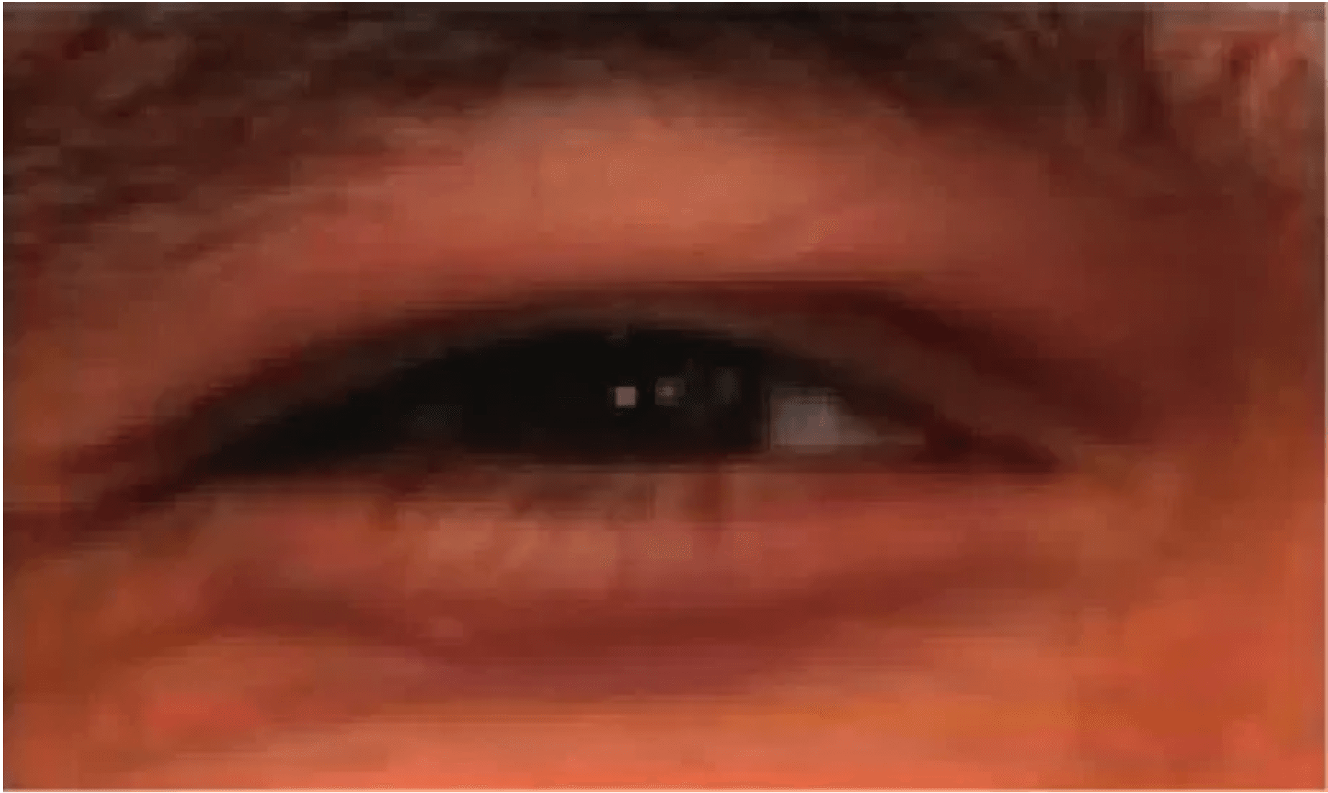
Final Thoughts and Q&A
Key Takeaways
★
Survey Insights:
Traditional iris recognition faces significant challenges in unconstrained environments, with deep learning emerging as a transformative solution
★
Data Augmentation:
Synthetic data generation is a powerful technique to overcome data scarcity and enable practical deep learning solutions
★
Wearable Biometrics:
Off-axis iris recognition in AR/VR devices is now achievable with >90% accuracy through innovative neural network design
★
Generalization:
Training diversity (viewing angles) enhances model robustness and generalization to real-world frontal iris images
★
Future Direction:
Combining theoretical understanding with practical engineering enables next-generation biometric authentication systems
Presenter Information
Name: MIA MD RAKIB
Student ID: 20233120001
Questions and Discussion
Thank you for your attention. I welcome your questions and discussion on iris recognition, deep learning approaches, and wearable biometric systems.

